Slide 1
Multiple Peptide Analysis with DL
최정인

Slide 2
Peptide(Gene)
Multiple peptide case gene : THBS1, BTD, ICAM1, LRG1, SERPINA5
AACR 2021 (14)
Patent (14)
NIQSLEVIGK(PPBP)
LLGIETPLPK(ICAM1)
ALLAFQESK(C4BPB)
LSLEIEQLELQR(C4BPA)
GLIDLTLDK(IFRD1)
ELLALIQLER(ECM1)
ILLAELEQLK(VIM)
DTEVLLVGLEPGTR(PTPRJ)
CINQLLCK(SEPP1)
NNLELSTPLK(PROS1)
DLLLPQPDLR(LRG1)
AGFSWIEVTFK(ITIH4)
VFSLQWGEVK(CFI)
DYFIATCK(C1R)
ILSGDPYCEK(BTD)
LSSGLVTAALYGR(BTD)
CA19-9
Bertis (18)
TIVTTLQDSIR(THBS1)
GFLLLASLR(THBS1)
TTSQVRPR(PF4)
IVDLLK(SERPINA5)
DHENELLNK(C2)
VSTLPAITLK(CTSD)
FDPSLTQR(SERPINF2)
LPGIVAEGR(SERPINC1)
AQLLLK(ICAM1)
ASCLYGQLPK(GSTP1)
DFVQPPTK(KNG1)
VAAGAFQGL(LRG1)
VDAETGDVFAIER(CDH5)
FEDENFILK(PPIA)
AFLLTPR(APOM)
GFYFSRPASR(IGF2)
NNLELSTPLK(PROS1)
DLLLPQPDLR(LRG1)
AADDTWEPFASGK
(TTR)
GFQQLLQELNQPR
(SERPINA5)
DSVTGTLPK(KLKB1)
LIQGAPTIR(IGFBP2)
ASSIIDELFQDR
(CLU)
NADYSYSVWK(C5)

Slide 3
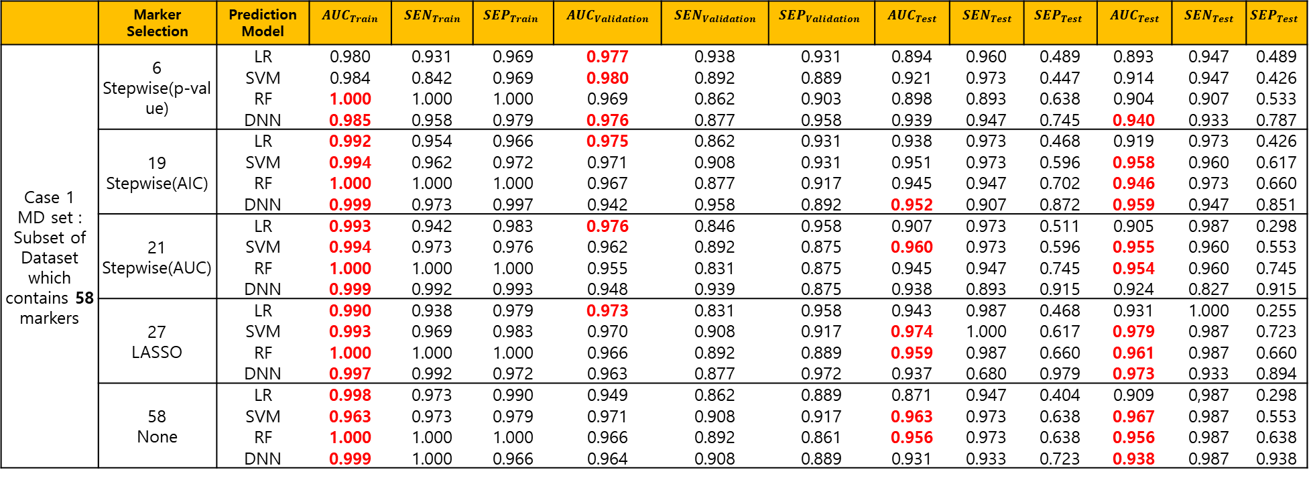
 | Marker Selection | Prediction Model | $$AUC_{Train}$$ | $$SEN_{Train}$$ | $$SEP_{Train}$$ | $$AUC_{Validation}$$ | $$SEN_{Validation}$$ | $$SEP_{Validation}$$ | $$AUC_{Test}$$ | $$SEN_{Test}$$ | $$SEP_{Test}$$ | $$AUC_{Test}$$ | $$SEN_{Test}$$ | $$SEP_{Test}$$
Case 1 MD set : Subset of Dataset which contains 58 markers | 6 Stepwise(p-value) | LR | 0.980 | 0.931 | 0.969 | 0.977 | 0.938 | 0.931 | 0.894 | 0.960 | 0.489 | 0.893 | 0.947 | 0.489
 |  | SVM | 0.984 | 0.842 | 0.969 | 0.980 | 0.892 | 0.889 | 0.921 | 0.973 | 0.447 | 0.914 | 0.947 | 0.426
 |  | RF | 1.000 | 1.000 | 1.000 | 0.969 | 0.862 | 0.903 | 0.898 | 0.893 | 0.638 | 0.904 | 0.907 | 0.533
 |  | DNN | 0.985 | 0.958 | 0.979 | 0.976 | 0.877 | 0.958 | 0.939 | 0.947 | 0.745 | 0.940 | 0.933 | 0.787
 | 19 Stepwise(AIC) | LR | 0.992 | 0.954 | 0.966 | 0.975 | 0.862 | 0.931 | 0.938 | 0.973 | 0.468 | 0.919 | 0.973 | 0.426
 |  | SVM | 0.994 | 0.962 | 0.972 | 0.971 | 0.908 | 0.931 | 0.951 | 0.973 | 0.596 | 0.958 | 0.960 | 0.617
 |  | RF | 1.000 | 1.000 | 1.000 | 0.967 | 0.877 | 0.917 | 0.945 | 0.947 | 0.702 | 0.946 | 0.973 | 0.660
 |  | DNN | 0.999 | 0.973 | 0.997 | 0.942 | 0.958 | 0.892 | 0.952 | 0.907 | 0.872 | 0.959 | 0.947 | 0.851
 | 21 Stepwise(AUC) | LR | 0.993 | 0.942 | 0.983 | 0.976 | 0.846 | 0.958 | 0.907 | 0.973 | 0.511 | 0.905 | 0.987 | 0.298
 |  | SVM | 0.994 | 0.973 | 0.976 | 0.962 | 0.892 | 0.875 | 0.960 | 0.973 | 0.596 | 0.955 | 0.960 | 0.553
 |  | RF | 1.000 | 1.000 | 1.000 | 0.955 | 0.831 | 0.875 | 0.945 | 0.947 | 0.745 | 0.954 | 0.960 | 0.745
 |  | DNN | 0.999 | 0.992 | 0.993 | 0.948 | 0.939 | 0.875 | 0.938 | 0.893 | 0.915 | 0.924 | 0.827 | 0.915
 | 27 LASSO | LR | 0.990 | 0.938 | 0.979 | 0.973 | 0.831 | 0.958 | 0.943 | 0.987 | 0.468 | 0.931 | 1.000 | 0.255
 |  | SVM | 0.993 | 0.969 | 0.983 | 0.970 | 0.908 | 0.917 | 0.974 | 1.000 | 0.617 | 0.979 | 0.987 | 0.723
 |  | RF | 1.000 | 1.000 | 1.000 | 0.966 | 0.892 | 0.889 | 0.959 | 0.987 | 0.660 | 0.961 | 0.987 | 0.660
 |  | DNN | 0.997 | 0.992 | 0.972 | 0.963 | 0.877 | 0.972 | 0.937 | 0.680 | 0.979 | 0.973 | 0.933 | 0.894
 | 58 None | LR | 0.998 | 0.973 | 0.990 | 0.949 | 0.862 | 0.889 | 0.871 | 0.947 | 0.404 | 0.909 | 0,987 | 0.298
 |  | SVM | 0.963 | 0.973 | 0.979 | 0.971 | 0.908 | 0.917 | 0.963 | 0.973 | 0.638 | 0.967 | 0.987 | 0.553
 |  | RF | 1.000 | 1.000 | 1.000 | 0.966 | 0.892 | 0.861 | 0.956 | 0.973 | 0.638 | 0.956 | 0.987 | 0.638
 |  | DNN | 0.999 | 1.000 | 0.966 | 0.964 | 0.908 | 0.889 | 0.931 | 0.933 | 0.723 | 0.938 | 0.987 | 0.938
Logistic regression with AACR markers
AACR | 0.989 (0.004) | 0.972 (0.014) | 0.952 (0.014) | 0.937 (0.018)

Slide 4
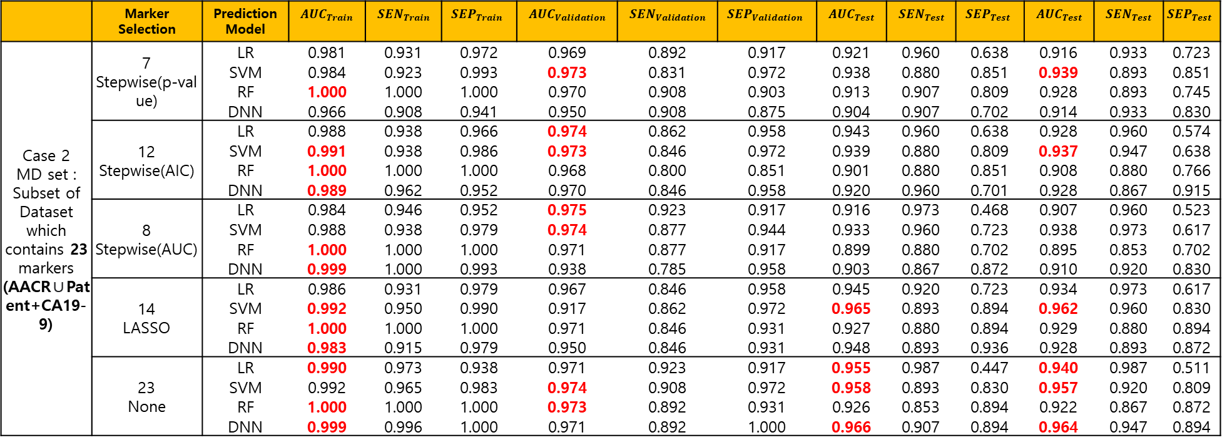
 | Marker Selection | Prediction Model | $$AUC_{Train}$$ | $$SEN_{Train}$$ | $$SEP_{Train}$$ | $$AUC_{Validation}$$ | $$SEN_{Validation}$$ | $$SEP_{Validation}$$ | $$AUC_{Test}$$ | $$SEN_{Test}$$ | $$SEP_{Test}$$ | $$AUC_{Test}$$ | $$SEN_{Test}$$ | $$SEP_{Test}$$
Case 2 MD set : Subset of Dataset which contains 23 markers (AACR∪Patent+CA19-9) | 7 Stepwise(p-value) | LR | 0.981 | 0.931 | 0.972 | 0.969 | 0.892 | 0.917 | 0.921 | 0.960 | 0.638 | 0.916 | 0.933 | 0.723
 |  | SVM | 0.984 | 0.923 | 0.993 | 0.973 | 0.831 | 0.972 | 0.938 | 0.880 | 0.851 | 0.939 | 0.893 | 0.851
 |  | RF | 1.000 | 1.000 | 1.000 | 0.970 | 0.908 | 0.903 | 0.913 | 0.907 | 0.809 | 0.928 | 0.893 | 0.745
 |  | DNN | 0.966 | 0.908 | 0.941 | 0.950 | 0.908 | 0.875 | 0.904 | 0.907 | 0.702 | 0.914 | 0.933 | 0.830
 | 12 Stepwise(AIC) | LR | 0.988 | 0.938 | 0.966 | 0.974 | 0.862 | 0.958 | 0.943 | 0.960 | 0.638 | 0.928 | 0.960 | 0.574
 |  | SVM | 0.991 | 0.938 | 0.986 | 0.973 | 0.846 | 0.972 | 0.939 | 0.880 | 0.809 | 0.937 | 0.947 | 0.638
 |  | RF | 1.000 | 1.000 | 1.000 | 0.968 | 0.800 | 0.851 | 0.901 | 0.880 | 0.851 | 0.908 | 0.880 | 0.766
 |  | DNN | 0.989 | 0.962 | 0.952 | 0.970 | 0.846 | 0.958 | 0.920 | 0.960 | 0.701 | 0.928 | 0.867 | 0.915
 | 8 Stepwise(AUC) | LR | 0.984 | 0.946 | 0.952 | 0.975 | 0.923 | 0.917 | 0.916 | 0.973 | 0.468 | 0.907 | 0.960 | 0.523
 |  | SVM | 0.988 | 0.938 | 0.979 | 0.974 | 0.877 | 0.944 | 0.933 | 0.960 | 0.723 | 0.938 | 0.973 | 0.617
 |  | RF | 1.000 | 1.000 | 1.000 | 0.971 | 0.877 | 0.917 | 0.899 | 0.880 | 0.702 | 0.895 | 0.853 | 0.702
 |  | DNN | 0.999 | 1.000 | 0.993 | 0.938 | 0.785 | 0.958 | 0.903 | 0.867 | 0.872 | 0.910 | 0.920 | 0.830
 | 14 LASSO | LR | 0.986 | 0.931 | 0.979 | 0.967 | 0.846 | 0.958 | 0.945 | 0.920 | 0.723 | 0.934 | 0.973 | 0.617
 |  | SVM | 0.992 | 0.950 | 0.990 | 0.917 | 0.862 | 0.972 | 0.965 | 0.893 | 0.894 | 0.962 | 0.960 | 0.830
 |  | RF | 1.000 | 1.000 | 1.000 | 0.971 | 0.846 | 0.931 | 0.927 | 0.880 | 0.894 | 0.929 | 0.880 | 0.894
 |  | DNN | 0.983 | 0.915 | 0.979 | 0.950 | 0.846 | 0.931 | 0.948 | 0.893 | 0.936 | 0.928 | 0.893 | 0.872
 | 23 None | LR | 0.990 | 0.973 | 0.938 | 0.971 | 0.923 | 0.917 | 0.955 | 0.987 | 0.447 | 0.940 | 0.987 | 0.511
 |  | SVM | 0.992 | 0.965 | 0.983 | 0.974 | 0.908 | 0.972 | 0.958 | 0.893 | 0.830 | 0.957 | 0.920 | 0.809
 |  | RF | 1.000 | 1.000 | 1.000 | 0.973 | 0.892 | 0.931 | 0.926 | 0.853 | 0.894 | 0.922 | 0.867 | 0.872
 |  | DNN | 0.999 | 0.996 | 1.000 | 0.971 | 0.892 | 1.000 | 0.966 | 0.907 | 0.894 | 0.964 | 0.947 | 0.894
Logistic regression with AACR markers
AACR | 0.989 (0.004) | 0.972 (0.014) | 0.952 (0.014) | 0.937 (0.018)

Slide 5
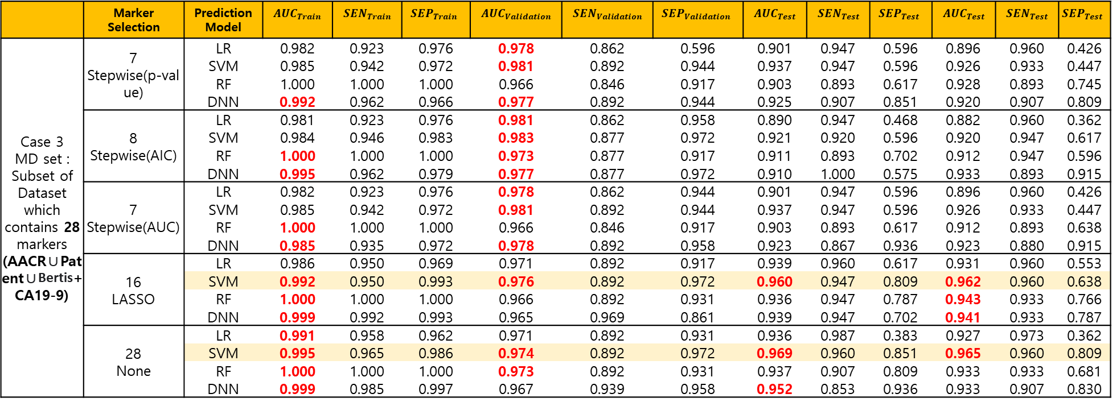
 | Marker Selection | Prediction Model | $$AUC_{Train}$$ | $$SEN_{Train}$$ | $$SEP_{Train}$$ | $$AUC_{Validation}$$ | $$SEN_{Validation}$$ | $$SEP_{Validation}$$ | $$AUC_{Test}$$ | $$SEN_{Test}$$ | $$SEP_{Test}$$ | $$AUC_{Test}$$ | $$SEN_{Test}$$ | $$SEP_{Test}$$
Case 3 MD set : Subset of Dataset which contains 28 markers (AACR∪Patent∪Bertis+CA19-9) | 7 Stepwise(p-value) | LR | 0.982 | 0.923 | 0.976 | 0.978 | 0.862 | 0.596 | 0.901 | 0.947 | 0.596 | 0.896 | 0.960 | 0.426
 |  | SVM | 0.985 | 0.942 | 0.972 | 0.981 | 0.892 | 0.944 | 0.937 | 0.947 | 0.596 | 0.926 | 0.933 | 0.447
 |  | RF | 1.000 | 1.000 | 1.000 | 0.966 | 0.846 | 0.917 | 0.903 | 0.893 | 0.617 | 0.928 | 0.893 | 0.745
 |  | DNN | 0.992 | 0.962 | 0.966 | 0.977 | 0.892 | 0.944 | 0.925 | 0.907 | 0.851 | 0.920 | 0.907 | 0.809
 | 8 Stepwise(AIC) | LR | 0.981 | 0.923 | 0.976 | 0.981 | 0.862 | 0.958 | 0.890 | 0.947 | 0.468 | 0.882 | 0.960 | 0.362
 |  | SVM | 0.984 | 0.946 | 0.983 | 0.983 | 0.877 | 0.972 | 0.921 | 0.920 | 0.596 | 0.920 | 0.947 | 0.617
 |  | RF | 1.000 | 1.000 | 1.000 | 0.973 | 0.877 | 0.917 | 0.911 | 0.893 | 0.702 | 0.912 | 0.947 | 0.596
 |  | DNN | 0.995 | 0.962 | 0.979 | 0.977 | 0.877 | 0.972 | 0.910 | 1.000 | 0.575 | 0.933 | 0.893 | 0.915
 | 7 Stepwise(AUC) | LR | 0.982 | 0.923 | 0.976 | 0.978 | 0.862 | 0.944 | 0.901 | 0.947 | 0.596 | 0.896 | 0.960 | 0.426
 |  | SVM | 0.985 | 0.942 | 0.972 | 0.981 | 0.892 | 0.944 | 0.937 | 0.947 | 0.596 | 0.926 | 0.933 | 0.447
 |  | RF | 1.000 | 1.000 | 1.000 | 0.966 | 0.846 | 0.917 | 0.903 | 0.893 | 0.617 | 0.912 | 0.893 | 0.638
 |  | DNN | 0.985 | 0.935 | 0.972 | 0.978 | 0.892 | 0.958 | 0.923 | 0.867 | 0.936 | 0.923 | 0.880 | 0.915
 | 16 LASSO | LR | 0.986 | 0.950 | 0.969 | 0.971 | 0.892 | 0.917 | 0.939 | 0.960 | 0.617 | 0.931 | 0.960 | 0.553
 |  | SVM | 0.992 | 0.950 | 0.993 | 0.976 | 0.892 | 0.972 | 0.960 | 0.947 | 0.809 | 0.962 | 0.960 | 0.638
 |  | RF | 1.000 | 1.000 | 1.000 | 0.966 | 0.892 | 0.931 | 0.936 | 0.947 | 0.787 | 0.943 | 0.933 | 0.766
 |  | DNN | 0.999 | 0.992 | 0.993 | 0.965 | 0.969 | 0.861 | 0.939 | 0.947 | 0.702 | 0.941 | 0.933 | 0.787
 | 28 None | LR | 0.991 | 0.958 | 0.962 | 0.971 | 0.892 | 0.931 | 0.936 | 0.987 | 0.383 | 0.927 | 0.973 | 0.362
 |  | SVM | 0.995 | 0.965 | 0.986 | 0.974 | 0.892 | 0.972 | 0.969 | 0.960 | 0.851 | 0.965 | 0.960 | 0.809
 |  | RF | 1.000 | 1.000 | 1.000 | 0.973 | 0.892 | 0.931 | 0.937 | 0.907 | 0.809 | 0.933 | 0.933 | 0.681
 |  | DNN | 0.999 | 0.985 | 0.997 | 0.967 | 0.939 | 0.958 | 0.952 | 0.853 | 0.936 | 0.933 | 0.907 | 0.830
Logistic regression with AACR markers
AACR | 0.989 (0.004) | 0.972 (0.014) | 0.952 (0.014) | 0.937 (0.018)

Slide 6
Multiple Peptide
Bertis Marker which we don’t have
Peptide
Gene Name | Peptide Sequence | Correlation
CLU | ASSIIDELFQDR | 0.73
 | TLLSNLEEAK
C5 | NADYSYSVWK | 0.78
 | GGSASTWLTAFALR
LRG1 | DLLLPQPDLR | 0.96
 | VAAGAFQGLR
ITIH4 | AGFSWIEVTFK | 0.77
 | LALDNGGLAR
BTD | ILSGDPYCEK | 0.92
 | LSSGLVTAALYGR
PPBP | NIQSLEVIGK | 0.83
 | ICLDPDAPR
SERPINC1 | IEDGFSLK | 0.84
 | VAEGTQVLELPFK
LDHB | GLTSVINQK | 0.79
 | IVVVTAGVR
CFH | GEWVALNPLR | 0.79
 | TGESVEFVCK
C4BPA | LSLEIEQLELQR | 0.88
 | TWYPEVPK
APOC1 | EFGNTLEDK | 0.91
 | EWFSETFQK
THBS1 | GFLLLASLR | 0.83
 | TIVTTLQDSIR
IGFBP3 | ALAQCAPPPAVCAELVR | 0.65
 | YGQPLPGYTTK
Gene Name | Peptide Sequence
TTR | AADDTWEPFASGK
KLKB1 | DSVTGTLPK
IGFBP2 | LIQGAPTIR
PROS1 | NNLELSTPLK
CFI | VFSLQWGEVK
C1R | DYFIATCK
C4BPB | ALLAFQESK
SOD3 | VTGVVLFR
MBL2 | FQASVATPR
ITIH2 | IQPSGGTNINEALLR
HRG | DGYLFQLLR
CTSD | VSTLPAITLK
C7 | VLFYVDSEK
C6 | TLNICEVGTIR
APOH | VCPFAGILENGAVR
AGT | DPTFIPAPIQAK
IFRD1 | GLIDLTLDK
ADIPOQ | GDIGETGVPGAEGPR
ECM1 | ELLALIQLER
C1S | TNFDNDIALVR
GSTP1 | ASCLYGQLPK
CORO1C | CDLISIPK
VIM | ILLAELEQLK
PTPRJ | DTEVLLVGLEPGTR
PKM2 | CDENILWLDYK
FCGBP | FAVLQENVAWGNGR
CPN2 | LSNNALSGLPQGVFGK
COL4A2 | GLPGEVLGAQPGPR
SERPINA5 | GFQQLLQELNQPR
SEPP1(SELENOP) | CINQLLCK
ICAM1 | LLGIETPLPK
Gene Name | Peptide Sequence
SERPINA5 | IVDLLK
SEPP1(SELENOP) | DDFLIYDR
ICAM1 | AQLLLK
SERPINC1 | LPGIVAEGR
CDH5 | VDAETGDVFAIER
PPIA | FEDENFILK
C2 | DHENELLNK
SERPINF2 | FDPSLTQR
KNG1 | DFVQPPTK
PF4 | TTSQVRPR
APOM | AFLLTPR
IGF2 | GFYFSRPASR

Slide 7
Marker Selection
 | Marker Selection | Selected Marker
Case 1 MD set : Subset of Dataset which contains 58 peptide markers | 6 Stepwise(p-value) | "Y ~ CA19_9 + LIQGAPTIR + TIVTTLQDSIR + NADYSYSVWK + ASSIIDELFQDR + DSVTGTLPK"
 | 19 Stepwise(AIC) | "Y ~ CA19_9 + ICLDPDAPR + GLPGEVLGAQPGPR + LIQGAPTIR + ASSIIDELFQDR + NADYSYSVWK + DSVTGTLPK + GFQQLLQELNQPR + LLGIETPLPK + NIQSLEVIGK + GLTSVINQK + DTEVLLVGLEPGTR + ELLALIQLER + LSLEIEQLELQR + ALLAFQESK + DYFIATCK + TNFDNDIALVR + IEDGFSLK + GGSASTWLTAFALR"
 | 21 Stepwise(AUC) | "Y ~ CA19_9 + LIQGAPTIR + GLPGEVLGAQPGPR + TIVTTLQDSIR + ALAQCAPPPAVCAELVR + NADYSYSVWK + ASSIIDELFQDR + VSTLPAITLK + DSVTGTLPK + LLGIETPLPK + LSLEIEQLELQR + NIQSLEVIGK + ELLALIQLER + ALLAFQESK + DYFIATCK + TNFDNDIALVR + IEDGFSLK + GGSASTWLTAFALR + DPTFIPAPIQAK + DTEVLLVGLEPGTR + GLTSVINQK"
 | 27 LASSO | "Y ~ CA19_9 + AADDTWEPFASGK + ALAQCAPPPAVCAELVR + ASSIIDELFQDR + CDENILWLDYK + CINQLLCK + DSVTGTLPK + DTEVLLVGLEPGTR + DYFIATCK + ELLALIQLER + GDIGETGVPGAEGPR + GFQQLLQELNQPR + GGSASTWLTAFALR + GLIDLTLDK + GLPGEVLGAQPGPR + GLTSVINQK + ICLDPDAPR + IEDGFSLK + ILLAELEQLK + LIQGAPTIR + LLGIETPLPK + LSLEIEQLELQR + NADYSYSVWK + NIQSLEVIGK + TIVTTLQDSIR + TLLSNLEEAK + VLFYVDSEK"
 | 58 None | "Y ~ CA19_9 + AADDTWEPFASGK + AGFSWIEVTFK + ALAQCAPPPAVCAELVR + ALLAFQESK + ASCLYGQLPK + ASSIIDELFQDR + CDENILWLDYK + CDLISIPK + CINQLLCK + DGYLFQLLR + DLLLPQPDLR + DPTFIPAPIQAK + DSVTGTLPK + DTEVLLVGLEPGTR + DYFIATCK + EFGNTLEDK + ELLALIQLER + EWFSETFQK + FAVLQENVAWGNGR + FQASVATPR + GDIGETGVPGAEGPR + GEWVALNPLR + GFLLLASLR + GFQQLLQELNQPR + GGSASTWLTAFALR + GLIDLTLDK + GLPGEVLGAQPGPR + GLTSVINQK + ICLDPDAPR + IEDGFSLK + ILLAELEQLK + ILSGDPYCEK + IQPSGGTNINEALLR + IVVVTAGVR + LALDNGGLAR + LIQGAPTIR + LLGIETPLPK + LSLEIEQLELQR + LSNNALSGLPQGVFGK + LSSGLVTAALYGR + NADYSYSVWK + NIQSLEVIGK + NNLELSTPLK + TGESVEFVCK + TIVTTLQDSIR + TLLSNLEEAK + TLNICEVGTIR + TNFDNDIALVR + TWYPEVPK + VAAGAFQGLR + VAEGTQVLELPFK + VCPFAGILENGAVR + VFSLQWGEVK + VLFYVDSEK + VSTLPAITLK + VTGVVLFR + YGQPLPGYTTK"
Case 4 MD set : Subset of Dataset which contains 45 protein markers by averaged peptide. | 7 Stepwise(p-value) | "Y ~ CA19_9 + LIQGAPTIR + GLPGEVLGAQPGPR + THBS1 + C5 + CLU + DSVTGTLPK"
 | 8 Stepwise(AIC) | "Y ~ CA19_9 + LIQGAPTIR + GLPGEVLGAQPGPR + THBS1 + DGYLFQLLR + LLGIETPLPK + CLU + C5"
 | 12 Stepwise(AUC) | "Y ~ CA19_9 + LIQGAPTIR + GLPGEVLGAQPGPR + THBS1 + DGYLFQLLR + LLGIETPLPK + ELLALIQLER + C5 + CLU + PPBP + SERPINC1 + DPTFIPAPIQAK"
 | 30 LASSO | "Y ~ CA19_9 + AADDTWEPFASGK + ASCLYGQLPK + CDENILWLDYK + CDLISIPK + CINQLLCK + DPTFIPAPIQAK + DSVTGTLPK + DTEVLLVGLEPGTR + DYFIATCK + ELLALIQLER + FAVLQENVAWGNGR + GDIGETGVPGAEGPR + GFQQLLQELNQPR + GLIDLTLDK + GLPGEVLGAQPGPR + ILLAELEQLK + LIQGAPTIR + LLGIETPLPK + VLFYVDSEK + CLU + C5 + LRG1 + ITIH4 + PPBP + SERPINC1 + LDHB + C4BPA + THBS1 + IGFBP3"
 | 45 None | "Y ~ CA19_9 + AADDTWEPFASGK + ALLAFQESK + ASCLYGQLPK + CDENILWLDYK + CDLISIPK + CINQLLCK + DGYLFQLLR + DPTFIPAPIQAK + DSVTGTLPK + DTEVLLVGLEPGTR + DYFIATCK + ELLALIQLER + FAVLQENVAWGNGR + FQASVATPR + GDIGETGVPGAEGPR + GFQQLLQELNQPR + GLIDLTLDK + GLPGEVLGAQPGPR + ILLAELEQLK + IQPSGGTNINEALLR + LIQGAPTIR + LLGIETPLPK + LSNNALSGLPQGVFGK + NNLELSTPLK + TLNICEVGTIR + TNFDNDIALVR + VCPFAGILENGAVR + VFSLQWGEVK + VLFYVDSEK + VSTLPAITLK + VTGVVLFR + CLU + C5 + LRG1 + ITIH4 + BTD + PPBP + SERPINC1 + LDHB + CFH + C4BPA + APOC1 + THBS1 + IGFBP3"

Slide 8
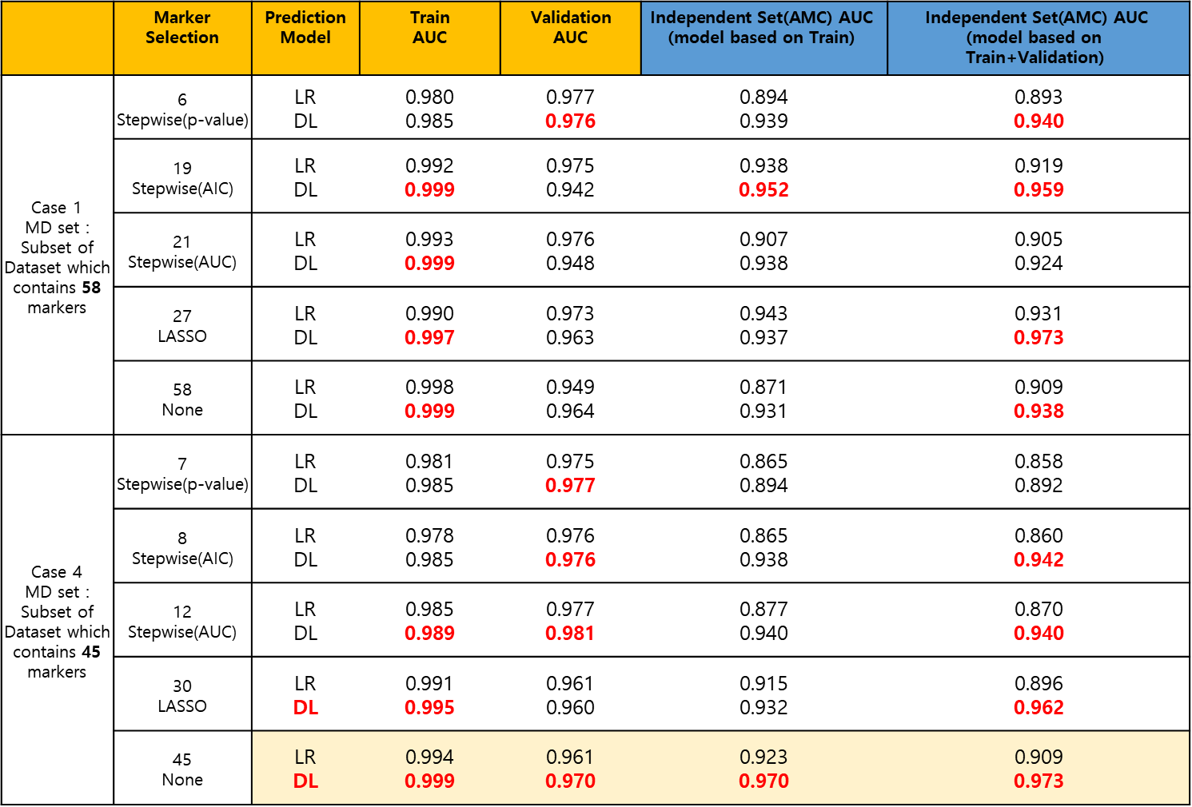
Result
 | Marker Selection | Prediction Model | $$\text{Train}$$ $$\text{AUC}$$ | $$\text{Validation}$$ $$\text{AUC}$$ | $$\text{Independent} \text{Set}\text{(}\text{AMC}\text{) }\text{AUC}$$ $$\text{(}\text{model} \text{based} \text{on} \text{Train}\text{)}$$ | $$\text{Independent} \text{Set}\text{(}\text{AMC}\text{) }\text{AUC}$$ $$\text{(}\text{model} \text{based} \text{on} \text{Train}\text{+}\text{Validation}\text{)}$$
Case 1 MD set : Subset of Dataset which contains 58 markers | 6 Stepwise(p-value) | LR DL | 0.980 0.985 | 0.977 0.976 | 0.894 0.939 | 0.893 0.940
 | 19 Stepwise(AIC) | LR DL | 0.992 0.999 | 0.975 0.942 | 0.938 0.952 | 0.919 0.959
 | 21 Stepwise(AUC) | LR DL | 0.993 0.999 | 0.976 0.948 | 0.907 0.938 | 0.905 0.924
 | 27 LASSO | LR DL | 0.990 0.997 | 0.973 0.963 | 0.943 0.937 | 0.931 0.973
 | 58 None | LR DL | 0.998 0.999 | 0.949 0.964 | 0.871 0.931 | 0.909 0.938
Case 4 MD set : Subset of Dataset which contains 45 markers | 7 Stepwise(p-value) | LR DL | 0.981 0.985 | 0.975 0.977 | 0.865 0.894 | 0.858 0.892
 | 8 Stepwise(AIC) | LR DL | 0.978 0.985 | 0.976 0.976 | 0.865 0.938 | 0.860 0.942
 | 12 Stepwise(AUC) | LR DL | 0.985 0.989 | 0.977 0.981 | 0.877 0.940 | 0.870 0.940
 | 30 LASSO | LR DL | 0.991 0.995 | 0.961 0.960 | 0.915 0.932 | 0.896 0.962
 | 45 None | LR DL | 0.994 0.999 | 0.961 0.970 | 0.923 0.970 | 0.909 0.973
Logistic regression with AACR markers
AACR | 0.989 (0.004) | 0.972 (0.014) | 0.952 (0.014) | 0.937 (0.018)

Slide 9
Marker Selection
 | Marker Selection | Selected Marker
Case 1 MD set : Subset of Dataset which contains 58 peptide markers | 6 Stepwise(p-value) | "Y ~ CA19_9 + LIQGAPTIR + TIVTTLQDSIR + NADYSYSVWK + ASSIIDELFQDR + DSVTGTLPK"
 | 19 Stepwise(AIC) | "Y ~ CA19_9 + ICLDPDAPR + GLPGEVLGAQPGPR + LIQGAPTIR + ASSIIDELFQDR + NADYSYSVWK + DSVTGTLPK + GFQQLLQELNQPR + LLGIETPLPK + NIQSLEVIGK + GLTSVINQK + DTEVLLVGLEPGTR + ELLALIQLER + LSLEIEQLELQR + ALLAFQESK + DYFIATCK + TNFDNDIALVR + IEDGFSLK + GGSASTWLTAFALR"
 | 21 Stepwise(AUC) | "Y ~ CA19_9 + LIQGAPTIR + GLPGEVLGAQPGPR + TIVTTLQDSIR + ALAQCAPPPAVCAELVR + NADYSYSVWK + ASSIIDELFQDR + VSTLPAITLK + DSVTGTLPK + LLGIETPLPK + LSLEIEQLELQR + NIQSLEVIGK + ELLALIQLER + ALLAFQESK + DYFIATCK + TNFDNDIALVR + IEDGFSLK + GGSASTWLTAFALR + DPTFIPAPIQAK + DTEVLLVGLEPGTR + GLTSVINQK"
 | 27 LASSO | "Y ~ CA19_9 + AADDTWEPFASGK + ALAQCAPPPAVCAELVR + ASSIIDELFQDR + CDENILWLDYK + CINQLLCK + DSVTGTLPK + DTEVLLVGLEPGTR + DYFIATCK + ELLALIQLER + GDIGETGVPGAEGPR + GFQQLLQELNQPR + GGSASTWLTAFALR + GLIDLTLDK + GLPGEVLGAQPGPR + GLTSVINQK + ICLDPDAPR + IEDGFSLK + ILLAELEQLK + LIQGAPTIR + LLGIETPLPK + LSLEIEQLELQR + NADYSYSVWK + NIQSLEVIGK + TIVTTLQDSIR + TLLSNLEEAK + VLFYVDSEK"
 | 58 None | "Y ~ CA19_9 + AADDTWEPFASGK + AGFSWIEVTFK + ALAQCAPPPAVCAELVR + ALLAFQESK + ASCLYGQLPK + ASSIIDELFQDR + CDENILWLDYK + CDLISIPK + CINQLLCK + DGYLFQLLR + DLLLPQPDLR + DPTFIPAPIQAK + DSVTGTLPK + DTEVLLVGLEPGTR + DYFIATCK + EFGNTLEDK + ELLALIQLER + EWFSETFQK + FAVLQENVAWGNGR + FQASVATPR + GDIGETGVPGAEGPR + GEWVALNPLR + GFLLLASLR + GFQQLLQELNQPR + GGSASTWLTAFALR + GLIDLTLDK + GLPGEVLGAQPGPR + GLTSVINQK + ICLDPDAPR + IEDGFSLK + ILLAELEQLK + ILSGDPYCEK + IQPSGGTNINEALLR + IVVVTAGVR + LALDNGGLAR + LIQGAPTIR + LLGIETPLPK + LSLEIEQLELQR + LSNNALSGLPQGVFGK + LSSGLVTAALYGR + NADYSYSVWK + NIQSLEVIGK + NNLELSTPLK + TGESVEFVCK + TIVTTLQDSIR + TLLSNLEEAK + TLNICEVGTIR + TNFDNDIALVR + TWYPEVPK + VAAGAFQGLR + VAEGTQVLELPFK + VCPFAGILENGAVR + VFSLQWGEVK + VLFYVDSEK + VSTLPAITLK + VTGVVLFR + YGQPLPGYTTK"
Case 5 MD set : Subset of Dataset which contains 45 protein markers by first principal component | 7 Stepwise(p-value) | "Y ~ CA19_9 + IGFBP2 + COL4A2 + THBS1 + C5 + CLU + KLKB1"
 | 8 Stepwise(AIC) | "Y ~ CA19_9 + IGFBP2 + COL4A2 + THBS1 + HRG + ICAM1 + CLU + C5"
 | 12 Stepwise(AUC) | "Y ~ CA19_9 + IGFBP2 + COL4A2 + THBS1 + HRG + ICAM1 + ECM1 + C5 + CLU + PPBP + SERPINC1 + AGT"
 | 30 LASSO | "Y ~ CA19_9 + TTR + GSTP1 + PKM2 + CORO1C + SEPP1 + AGT + KLKB1 + PTPRJ + C1R + ECM1 + FCGBP + ADIPOQ + SERPINA5 + IFRD1 + COL4A2 + VIM + IGFBP2 + ICAM1 + C7 + CLU + C5 + LRG1 + ITIH4 + PPBP + SERPINC1 + LDHB + C4BPA + THBS1 + IGFBP3"
 | 45 None | "Y ~ CA19_9 + TTR + C4BPB + GSTP1 + PKM2 + CORO1C + SEPP1 + HRG + AGT + KLKB1 + PTPRJ + C1R + ECM1 + FCGBP + MBL2 + ADIPOQ + SERPINA5 + IFRD1 + COL4A2 + VIM + ITIH2 + IGFBP2 + ICAM1 + CPN2 + PROS1 + C6 + C1S + APOH + CFI + C7 + CTSD + SOD3 + CLU + C5 + LRG1 + ITIH4 + BTD + PPBP + SERPINC1 + LDHB + CFH + C4BPA + APOC1 + THBS1 + IGFBP3"

Slide 10
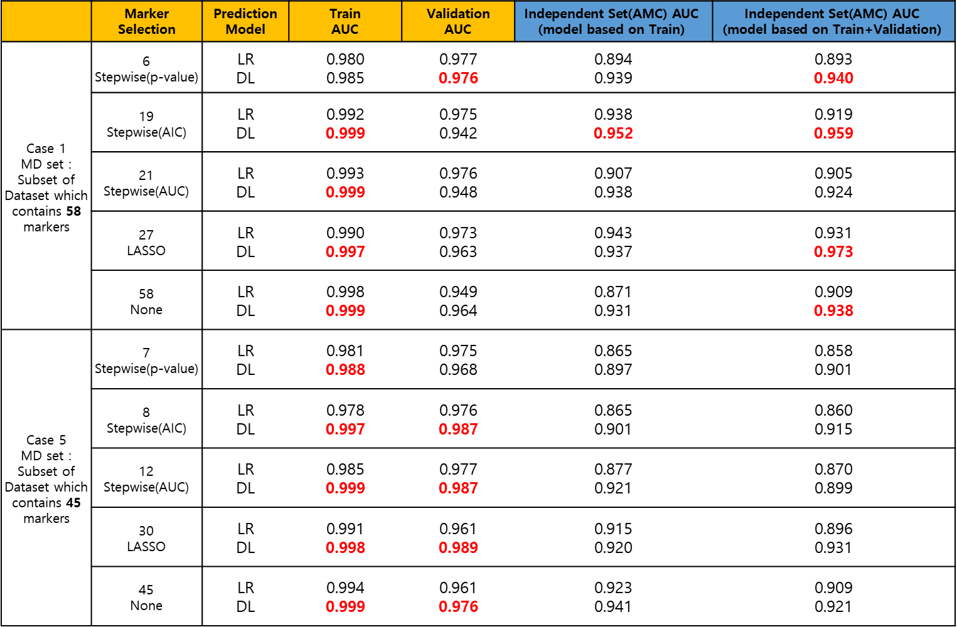
Result
 | Marker Selection | Prediction Model | $$\text{Train}$$ $$\text{AUC}$$ | $$\text{Validation}$$ $$\text{AUC}$$ | $$\text{Independent} \text{Set}\text{(}\text{AMC}\text{) }\text{AUC}$$ $$\text{(}\text{model} \text{based} \text{on} \text{Train}\text{)}$$ | $$\text{Independent} \text{Set}\text{(}\text{AMC}\text{) }\text{AUC}$$ $$\text{(}\text{model} \text{based} \text{on} \text{Train}\text{+}\text{Validation}\text{)}$$
Case 1 MD set : Subset of Dataset which contains 58 markers | 6 Stepwise(p-value) | LR DL | 0.980 0.985 | 0.977 0.976 | 0.894 0.939 | 0.893 0.940
 | 19 Stepwise(AIC) | LR DL | 0.992 0.999 | 0.975 0.942 | 0.938 0.952 | 0.919 0.959
 | 21 Stepwise(AUC) | LR DL | 0.993 0.999 | 0.976 0.948 | 0.907 0.938 | 0.905 0.924
 | 27 LASSO | LR DL | 0.990 0.997 | 0.973 0.963 | 0.943 0.937 | 0.931 0.973
 | 58 None | LR DL | 0.998 0.999 | 0.949 0.964 | 0.871 0.931 | 0.909 0.938
Case 5 MD set : Subset of Dataset which contains 45 markers | 7 Stepwise(p-value) | LR DL | 0.981 0.988 | 0.975 0.968 | 0.865 0.897 | 0.858 0.901
 | 8 Stepwise(AIC) | LR DL | 0.978 0.997 | 0.976 0.987 | 0.865 0.901 | 0.860 0.915
 | 12 Stepwise(AUC) | LR DL | 0.985 0.999 | 0.977 0.987 | 0.877 0.921 | 0.870 0.899
 | 30 LASSO | LR DL | 0.991 0.998 | 0.961 0.989 | 0.915 0.920 | 0.896 0.931
 | 45 None | LR DL | 0.994 0.999 | 0.961 0.976 | 0.923 0.941 | 0.909 0.921
Logistic regression with AACR markers
AACR | 0.989 (0.004) | 0.972 (0.014) | 0.952 (0.014) | 0.937 (0.018)

Slide 11
Multiple Peptide
Bertis Marker which we don’t have
Peptide
Gene Name | Peptide Sequence | Correlation
CLU | ASSIIDELFQDR | 0.73
 | TLLSNLEEAK
C5 | NADYSYSVWK | 0.78
 | GGSASTWLTAFALR
LRG1 | DLLLPQPDLR | 0.96
 | VAAGAFQGLR
ITIH4 | AGFSWIEVTFK | 0.77
 | LALDNGGLAR
BTD | ILSGDPYCEK | 0.92
 | LSSGLVTAALYGR
PPBP | NIQSLEVIGK | 0.83
 | ICLDPDAPR
SERPINC1 | IEDGFSLK | 0.84
 | VAEGTQVLELPFK
LDHB | GLTSVINQK | 0.79
 | IVVVTAGVR
CFH | GEWVALNPLR | 0.79
 | TGESVEFVCK
C4BPA | LSLEIEQLELQR | 0.88
 | TWYPEVPK
APOC1 | EFGNTLEDK | 0.91
 | EWFSETFQK
THBS1 | GFLLLASLR | 0.83
 | TIVTTLQDSIR
IGFBP3 | ALAQCAPPPAVCAELVR | 0.65
 | YGQPLPGYTTK
Gene Name | Peptide Sequence
TTR | AADDTWEPFASGK
KLKB1 | DSVTGTLPK
IGFBP2 | LIQGAPTIR
PROS1 | NNLELSTPLK
CFI | VFSLQWGEVK
C1R | DYFIATCK
C4BPB | ALLAFQESK
SOD3 | VTGVVLFR
MBL2 | FQASVATPR
ITIH2 | IQPSGGTNINEALLR
HRG | DGYLFQLLR
CTSD | VSTLPAITLK
C7 | VLFYVDSEK
C6 | TLNICEVGTIR
APOH | VCPFAGILENGAVR
AGT | DPTFIPAPIQAK
IFRD1 | GLIDLTLDK
ADIPOQ | GDIGETGVPGAEGPR
ECM1 | ELLALIQLER
C1S | TNFDNDIALVR
GSTP1 | ASCLYGQLPK
CORO1C | CDLISIPK
VIM | ILLAELEQLK
PTPRJ | DTEVLLVGLEPGTR
PKM2 | CDENILWLDYK
FCGBP | FAVLQENVAWGNGR
CPN2 | LSNNALSGLPQGVFGK
COL4A2 | GLPGEVLGAQPGPR
SERPINA5 | GFQQLLQELNQPR
SEPP1(SELENOP) | CINQLLCK
ICAM1 | LLGIETPLPK
Gene Name | Peptide Sequence
SERPINA5 | IVDLLK
SEPP1(SELENOP) | DDFLIYDR
ICAM1 | AQLLLK
SERPINC1 | LPGIVAEGR
CDH5 | VDAETGDVFAIER
PPIA | FEDENFILK
C2 | DHENELLNK
SERPINF2 | FDPSLTQR
KNG1 | DFVQPPTK
PF4 | TTSQVRPR
APOM | AFLLTPR
IGF2 | GFYFSRPASR

Slide 12
Hyperparameter Tuning of DL on Train/Validation
Activation function : Rectifier / Tanh / Maxout
Input dropout ratio : 0 / 0.05 / 0.1 / 0.2
Epochs : 20 /30 /40 /50 /60 /70 /80 /90 /100 /200 / 300 / 400 / 500 / 600 / 700 / 800
Epsilon : 1e-4 /1e-5 /1e-6 / 1e-7 / 1e-8 / 1e-9 / 1e-10
Train sample per iteration : 0 / -1 / -2
To specify one epoch, enter 0. To specify all available data, enter -1. To use the automatic values, enter -2
2688 combination

Slide 13
Peptide
ith(i>1) layers are fully connected
Network 1 itself are fully connected but they are not fully connected to each other.
ASSIIDELFQDR
CLU
TLLSNLEEAK
. . . .
(fully connected hidden layers)
C5
NADYSYSVWK
Output layer
GGSASTWLTAFALR
LRG1
DLLLPQPDLR
VAAGAFQGLR
. . . .
Input Layer

Slide 14
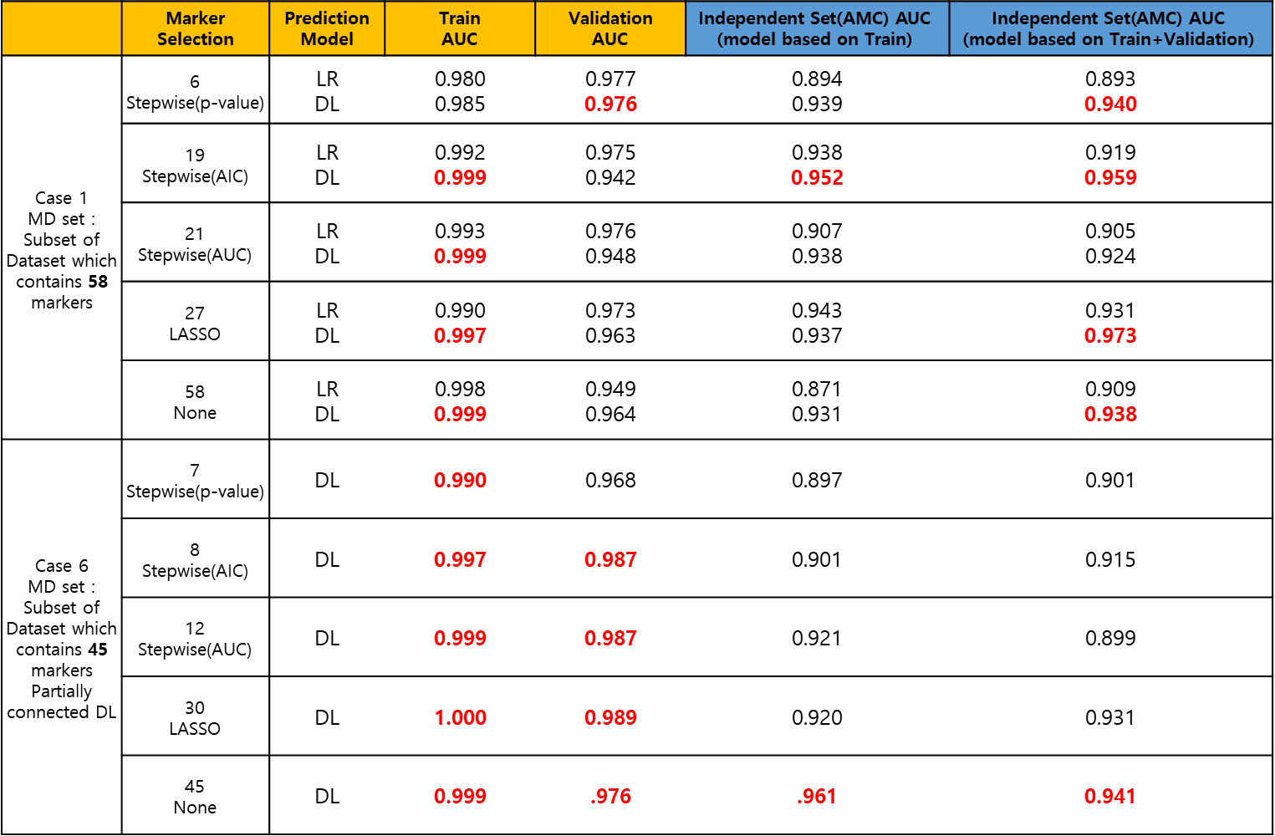
Result
 | Marker Selection | Prediction Model | $$\text{Train}$$ $$\text{AUC}$$ | $$\text{Validation}$$ $$\text{AUC}$$ | $$\text{Independent} \text{Set}\text{(}\text{AMC}\text{) }\text{AUC}$$ $$\text{(}\text{model} \text{based} \text{on} \text{Train}\text{)}$$ | $$\text{Independent} \text{Set}\text{(}\text{AMC}\text{) }\text{AUC}$$ $$\text{(}\text{model} \text{based} \text{on} \text{Train}\text{+}\text{Validation}\text{)}$$
Case 1 MD set : Subset of Dataset which contains 58 markers | 6 Stepwise(p-value) | LR DL | 0.980 0.985 | 0.977 0.976 | 0.894 0.939 | 0.893 0.940
 | 19 Stepwise(AIC) | LR DL | 0.992 0.999 | 0.975 0.942 | 0.938 0.952 | 0.919 0.959
 | 21 Stepwise(AUC) | LR DL | 0.993 0.999 | 0.976 0.948 | 0.907 0.938 | 0.905 0.924
 | 27 LASSO | LR DL | 0.990 0.997 | 0.973 0.963 | 0.943 0.937 | 0.931 0.973
 | 58 None | LR DL | 0.998 0.999 | 0.949 0.964 | 0.871 0.931 | 0.909 0.938
Case 6 MD set : Subset of Dataset which contains 45 markers Partially connected DL | 7 Stepwise(p-value) | DL | 0.990 | 0.968 | 0.897 | 0.901
 | 8 Stepwise(AIC) | DL | 0.997 | 0.987 | 0.901 | 0.915
 | 12 Stepwise(AUC) | DL | 0.999 | 0.987 | 0.921 | 0.899
 | 30 LASSO | DL | 1.000 | 0.989 | 0.920 | 0.931
 | 45 None | DL | 0.999 | .976 | .961 | 0.941
Logistic regression with AACR markers
AACR | 0.989 (0.004) | 0.972 (0.014) | 0.952 (0.014) | 0.937 (0.018)

Slide 15
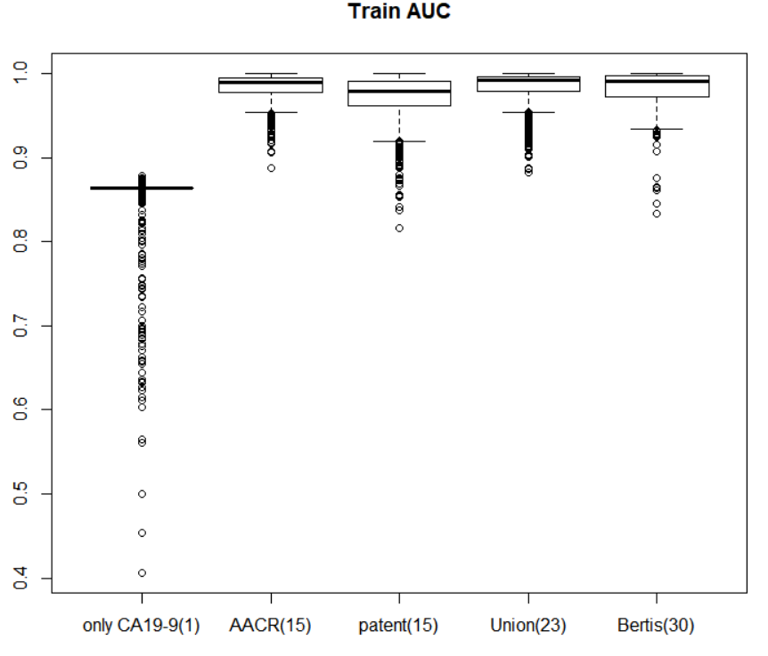
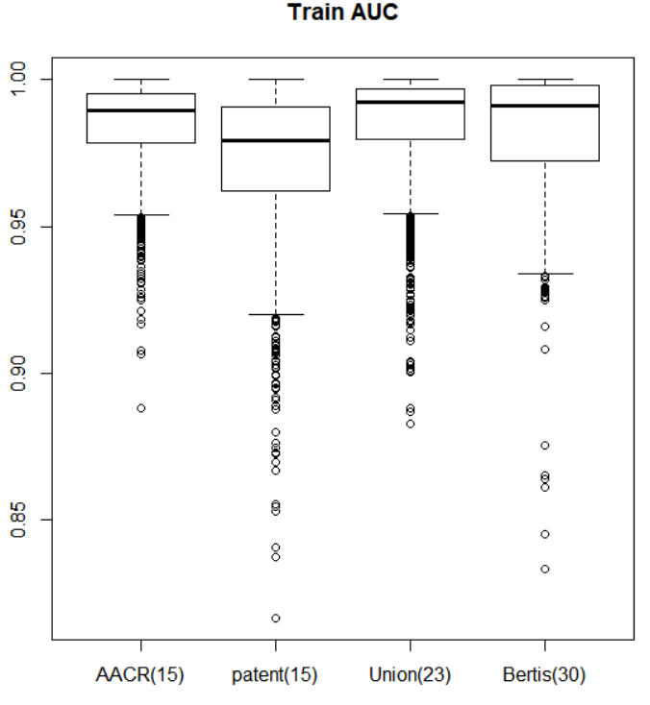
Summary : Train AUC for different combination of biomarkers

Slide 16
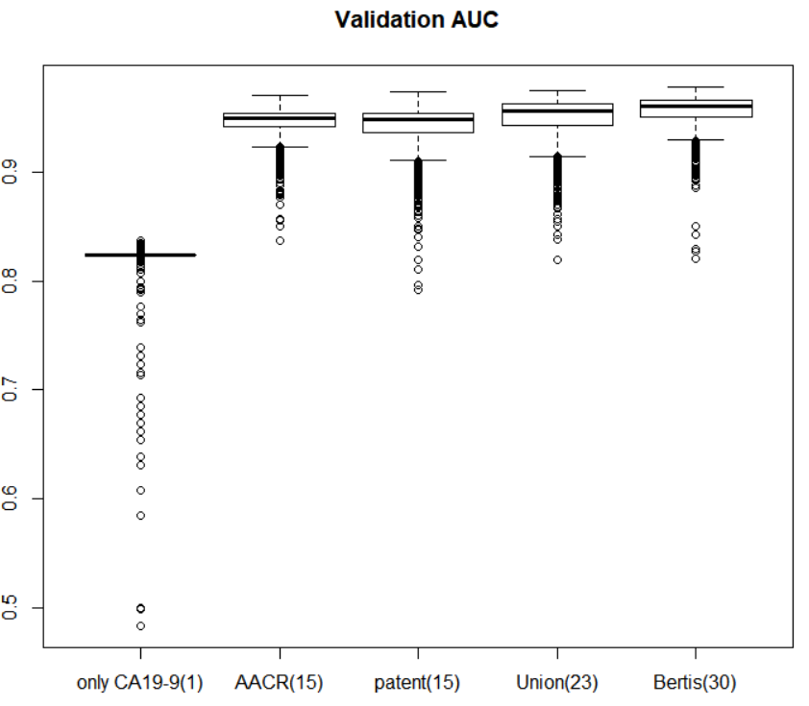
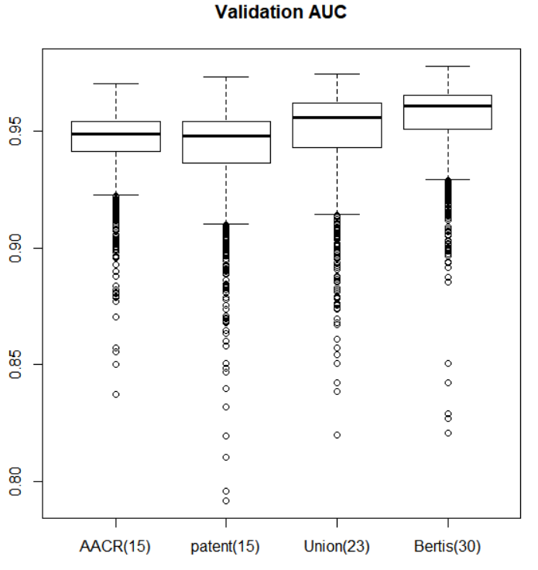
Summary : Validation AUC for different combination of biomarkers

Slide 17
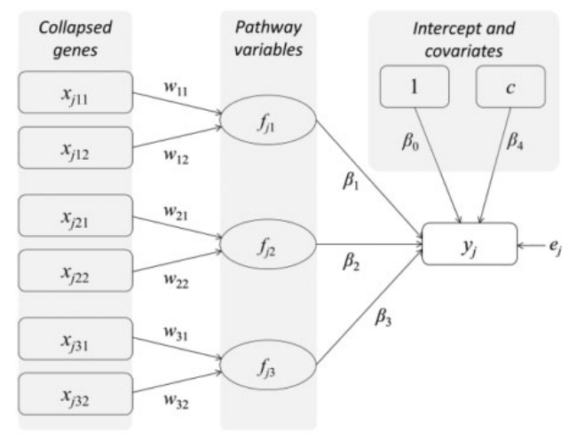
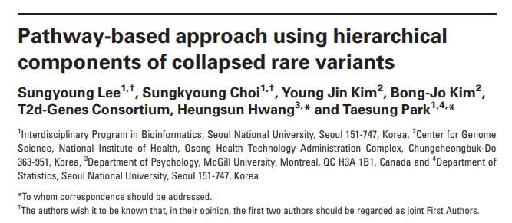



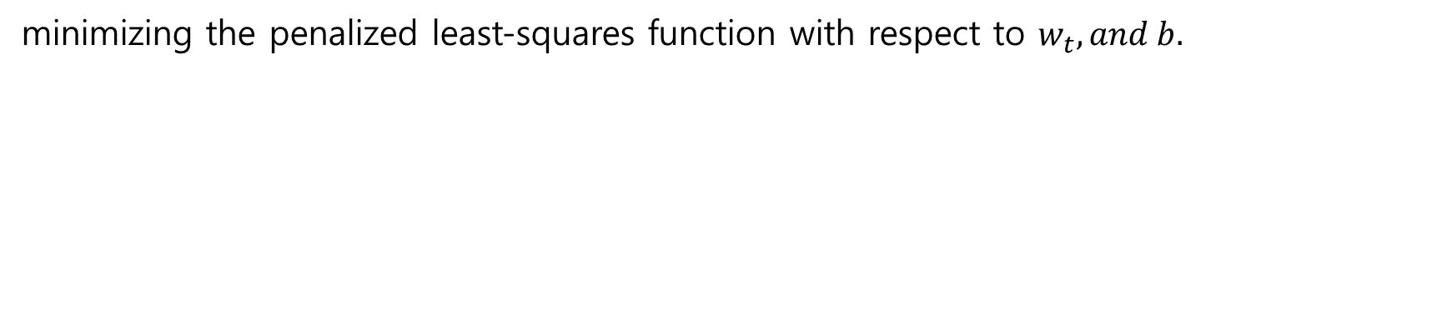
Application of HisCoM
minimizing the penalized least-squares function with respect to $w_{t}, and b.$

Slide 18
Application of HisCoM – First Layer(nn.Linear)
Peptide (31)
AADDTWEPFASGK
DSVTGTLPK
LIQGAPTIR
NNLELSTPLK
VFSLQWGEVK
DYFIATCK
ALLAFQESK
VTGVVLFR
FQASVATPR
IQPSGGTNINEALLR
DGYLFQLLR
VSTLPAITLK
VLFYVDSEK
TLNICEVGTIR
VCPFAGILENGAVR
DPTFIPAPIQAK
GLIDLTLDK
GDIGETGVPGAEGPR
ELLALIQLER
TNFDNDIALVR
ASCLYGQLPK
CDLISIPK
ILLAELEQLK
DTEVLLVGLEPGTR
CDENILWLDYK
FAVLQENVAWGNGR
LSNNALSGLPQGVFGK
GLPGEVLGAQPGPR
GFQQLLQELNQPR
CINQLLCK
LLGIETPLPK
Protein (31)
TTR
KLKB1
IGFBP2
PROS1
CFI
C1R
C4BPB
SOD3
MBL2
ITIH2
HRG
CTSD
C7
C6
APOH
AGT
IFRD1
ADIPOQ
ECM1
C1S
GSTP1
CORO1C
VIM
PTPRJ
PKM2
FCGBP
CPN2
COL4A2
SERPINA5
SEPP1(SELENOP)
ICAM1
Peptide (26)
ASSIIDELFQDR
TLLSNLEEAK
NADYSYSVWK
GGSASTWLTAFALR
DLLLPQPDLR
VAAGAFQGLR
AGFSWIEVTFK
LALDNGGLAR
ILSGDPYCEK
LSSGLVTAALYGR
NIQSLEVIGK
ICLDPDAPR
IEDGFSLK
VAEGTQVLELPFK
GLTSVINQK
IVVVTAGVR
GEWVALNPLR
TGESVEFVCK
LSLEIEQLELQR
TWYPEVPK
EFGNTLEDK
EWFSETFQK
GFLLLASLR
TIVTTLQDSIR
ALAQCAPPPAVCAELVR
YGQPLPGYTTK
Protein (13)
CLU
C5
LRG1
ITIH4
BTD
PPBP
SERPINC1
LDHB
CFH
C4BPA
APOC1
THBS1
IGFBP3

Slide 19
Application of HisCoM – Second Layer(nn.Linear)
Protein (31)
TTR
KLKB1
IGFBP2
PROS1
CFI
C1R
C4BPB
SOD3
MBL2
ITIH2
HRG
CTSD
C7
C6
APOH
AGT
IFRD1
ADIPOQ
ECM1
C1S
GSTP1
CORO1C
VIM
PTPRJ
PKM2
FCGBP
CPN2
COL4A2
SERPINA5
SEPP1(SELENOP)
ICAM1
Protein(13)
CLU
C5
LRG1
ITIH4
BTD
PPBP
SERPINC1
LDHB
CFH
C4BPA
APOC1
THBS1
IGFBP3
nn.Linear
nn.Linear
Sigmoid
Sigmoid
Hidden Layer with Length 1
Hidden Layer with Length 1
Group
Group

Slide 20
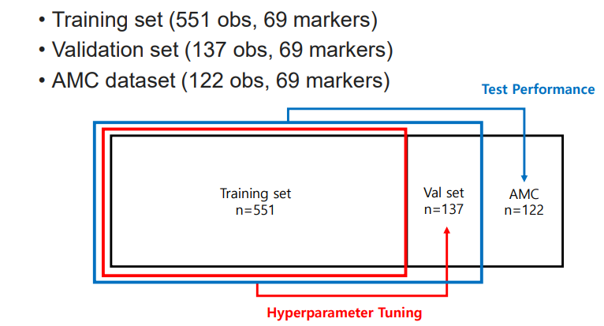
Application of HisCoM – Hyperparameter Tuning
Best Model Selected Based on Training Data
1. Number of epochs = 80
2. learning_rate = 1
3. penalty_pathHCC = 0.2
4. penalty_metpath = 0
Penalty for first/second/parameter
in LBFGS optimization

Slide 21
Application of HisCoM – First Layer(nn.Linear)
Peptide (31)
AADDTWEPFASGK
DSVTGTLPK
LIQGAPTIR
NNLELSTPLK
VFSLQWGEVK
DYFIATCK
ALLAFQESK
VTGVVLFR
FQASVATPR
IQPSGGTNINEALLR
DGYLFQLLR
VSTLPAITLK
VLFYVDSEK
TLNICEVGTIR
VCPFAGILENGAVR
DPTFIPAPIQAK
GLIDLTLDK
GDIGETGVPGAEGPR
ELLALIQLER
TNFDNDIALVR
ASCLYGQLPK
CDLISIPK
ILLAELEQLK
DTEVLLVGLEPGTR
CDENILWLDYK
FAVLQENVAWGNGR
LSNNALSGLPQGVFGK
GLPGEVLGAQPGPR
GFQQLLQELNQPR
CINQLLCK
LLGIETPLPK
Protein (31)
TTR
KLKB1
IGFBP2
PROS1
CFI
C1R
C4BPB
SOD3
MBL2
ITIH2
HRG
CTSD
C7
C6
APOH
AGT
IFRD1
ADIPOQ
ECM1
C1S
GSTP1
CORO1C
VIM
PTPRJ
PKM2
FCGBP
CPN2
COL4A2
SERPINA5
SEPP1(SELENOP)
ICAM1
Peptide (26)
ASSIIDELFQDR
TLLSNLEEAK
NADYSYSVWK
GGSASTWLTAFALR
DLLLPQPDLR
VAAGAFQGLR
AGFSWIEVTFK
LALDNGGLAR
ILSGDPYCEK
LSSGLVTAALYGR
NIQSLEVIGK
ICLDPDAPR
IEDGFSLK
VAEGTQVLELPFK
GLTSVINQK
IVVVTAGVR
GEWVALNPLR
TGESVEFVCK
LSLEIEQLELQR
TWYPEVPK
EFGNTLEDK
EWFSETFQK
GFLLLASLR
TIVTTLQDSIR
ALAQCAPPPAVCAELVR
YGQPLPGYTTK
Protein (13)
CLU
C5
LRG1
ITIH4
BTD
PPBP
SERPINC1
LDHB
CFH
C4BPA
APOC1
THBS1
IGFBP3

Slide 22
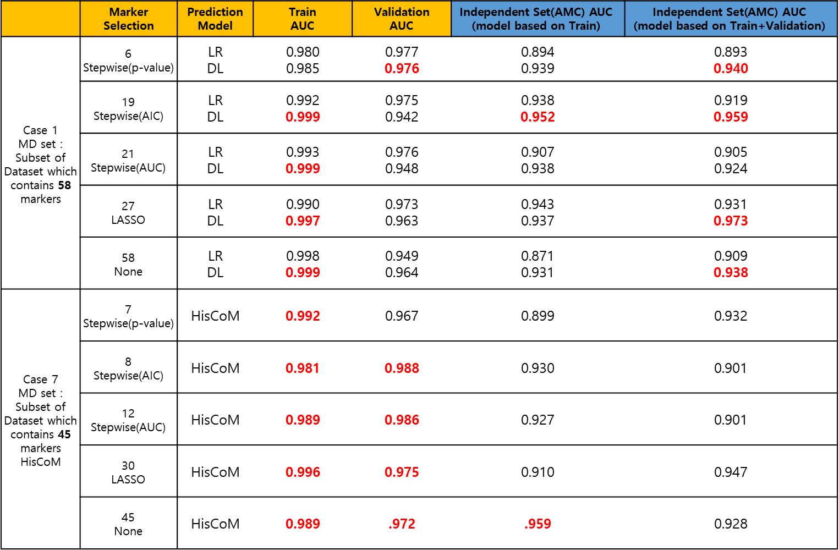
Result
 | Marker Selection | Prediction Model | $$\text{Train}$$ $$\text{AUC}$$ | $$\text{Validation}$$ $$\text{AUC}$$ | $$\text{Independent} \text{Set}\text{(}\text{AMC}\text{) }\text{AUC}$$ $$\text{(}\text{model} \text{based} \text{on} \text{Train}\text{)}$$ | $$\text{Independent} \text{Set}\text{(}\text{AMC}\text{) }\text{AUC}$$ $$\text{(}\text{model} \text{based} \text{on} \text{Train}\text{+}\text{Validation}\text{)}$$
Case 1 MD set : Subset of Dataset which contains 58 markers | 6 Stepwise(p-value) | LR DL | 0.980 0.985 | 0.977 0.976 | 0.894 0.939 | 0.893 0.940
 | 19 Stepwise(AIC) | LR DL | 0.992 0.999 | 0.975 0.942 | 0.938 0.952 | 0.919 0.959
 | 21 Stepwise(AUC) | LR DL | 0.993 0.999 | 0.976 0.948 | 0.907 0.938 | 0.905 0.924
 | 27 LASSO | LR DL | 0.990 0.997 | 0.973 0.963 | 0.943 0.937 | 0.931 0.973
 | 58 None | LR DL | 0.998 0.999 | 0.949 0.964 | 0.871 0.931 | 0.909 0.938
Case 7 MD set : Subset of Dataset which contains 45 markers HisCoM | 7 Stepwise(p-value) | HisCoM | 0.992 | 0.967 | 0.899 | 0.932
 | 8 Stepwise(AIC) | HisCoM | 0.981 | 0.988 | 0.930 | 0.901
 | 12 Stepwise(AUC) | HisCoM | 0.989 | 0.986 | 0.927 | 0.901
 | 30 LASSO | HisCoM | 0.996 | 0.975 | 0.910 | 0.947
 | 45 None | HisCoM | 0.989 | .972 | .959 | 0.928
Logistic regression with AACR markers
AACR | 0.989 (0.004) | 0.972 (0.014) | 0.952 (0.014) | 0.937 (0.018)

Slide 23
Application of HisCoM – First Layer(nn.Linear)
Peptide (31)
AADDTWEPFASGK
DSVTGTLPK
LIQGAPTIR
NNLELSTPLK
VFSLQWGEVK
DYFIATCK
ALLAFQESK
VTGVVLFR
FQASVATPR
IQPSGGTNINEALLR
DGYLFQLLR
VSTLPAITLK
VLFYVDSEK
TLNICEVGTIR
VCPFAGILENGAVR
DPTFIPAPIQAK
GLIDLTLDK
GDIGETGVPGAEGPR
ELLALIQLER
TNFDNDIALVR
ASCLYGQLPK
CDLISIPK
ILLAELEQLK
DTEVLLVGLEPGTR
CDENILWLDYK
FAVLQENVAWGNGR
LSNNALSGLPQGVFGK
GLPGEVLGAQPGPR
GFQQLLQELNQPR
CINQLLCK
LLGIETPLPK
Protein (31)
TTR
KLKB1
IGFBP2
PROS1
CFI
C1R
C4BPB
SOD3
MBL2
ITIH2
HRG
CTSD
C7
C6
APOH
AGT
IFRD1
ADIPOQ
ECM1
C1S
GSTP1
CORO1C
VIM
PTPRJ
PKM2
FCGBP
CPN2
COL4A2
SERPINA5
SEPP1(SELENOP)
ICAM1
Peptide (26)
ASSIIDELFQDR
TLLSNLEEAK
NADYSYSVWK
GGSASTWLTAFALR
DLLLPQPDLR
VAAGAFQGLR
AGFSWIEVTFK
LALDNGGLAR
ILSGDPYCEK
LSSGLVTAALYGR
NIQSLEVIGK
ICLDPDAPR
IEDGFSLK
VAEGTQVLELPFK
GLTSVINQK
IVVVTAGVR
GEWVALNPLR
TGESVEFVCK
LSLEIEQLELQR
TWYPEVPK
EFGNTLEDK
EWFSETFQK
GFLLLASLR
TIVTTLQDSIR
ALAQCAPPPAVCAELVR
YGQPLPGYTTK
Protein (13)
CLU
C5
LRG1
ITIH4
BTD
PPBP
SERPINC1
LDHB
CFH
C4BPA
APOC1
THBS1
IGFBP3

Slide 24

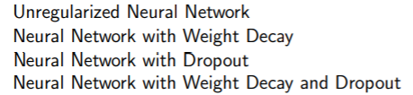
Marker Selection Using DL method

Slide 25
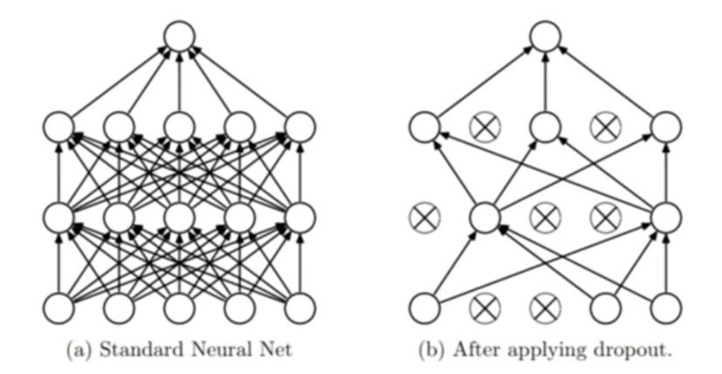
Marker Selection Using DL method: Dropout
학습 단계에서 무작위로 신경망의 일부 뉴런들을 제외

Slide 26
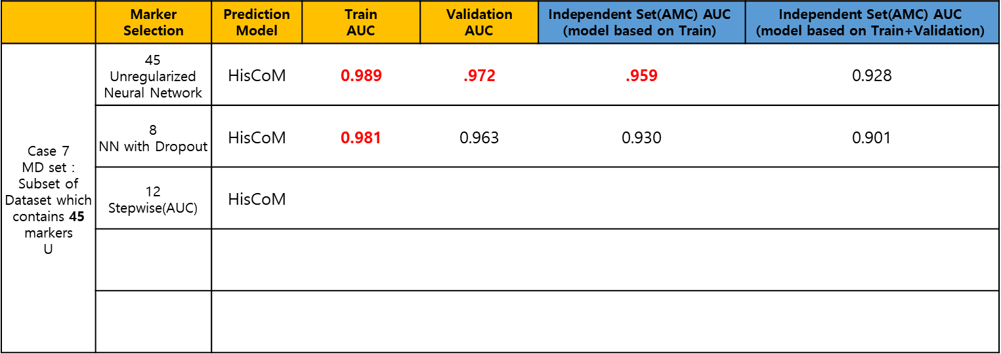
Result
 | Marker Selection | Prediction Model | $$\text{Train}$$ $$\text{AUC}$$ | $$\text{Validation}$$ $$\text{AUC}$$ | $$\text{Independent} \text{Set}\text{(}\text{AMC}\text{) }\text{AUC}$$ $$\text{(}\text{model} \text{based} \text{on} \text{Train}\text{)}$$ | $$\text{Independent} \text{Set}\text{(}\text{AMC}\text{) }\text{AUC}$$ $$\text{(}\text{model} \text{based} \text{on} \text{Train}\text{+}\text{Validation}\text{)}$$
Case 7 MD set : Subset of Dataset which contains 45 markers U | 45 Unregularized Neural Network | HisCoM | 0.989 | .972 | .959 | 0.928
 | 8 NN with Dropout | HisCoM | 0.981 | 0.963 | 0.930 | 0.901
 | 12 Stepwise(AUC) | HisCoM
Logistic regression with AACR markers
AACR | 0.989 (0.004) | 0.972 (0.014) | 0.952 (0.014) | 0.937 (0.018)

